Slide 1
Diffie-Hellman Key exchange
Dr.A.Neela Madheswari
Professor
Mahendra Engineering College

Slide 2
Introduction
Diffie-Hellman algorithm was developed in 1976 by Whitfield Diffie and Martin Hellman - thus the name Diffie Hellman
This algorithm is not used to encrypt the data
It is used for generating the secret key between the sender and the receiver
Asymmetric Encryption requires the transfer of a private key between the sender and the receiver of data
One of the challenging parts of Asymmetric Encryption is the safe and secure transfer of the secret key between the sender and the receiver
No one should have access or intercept the secret key during the transfer
This transfer or rather generation of the secret key at both sides was facilitated by the Diffie-Hellman algorithm

Slide 3
Inputs for the algorithm
Four variables to be considered:
p (prime) Example: 23
g (primitive root of p) (g has no common factor in common with p) Example: 9
a and b (private values of two users) Example: 4,3

Slide 4
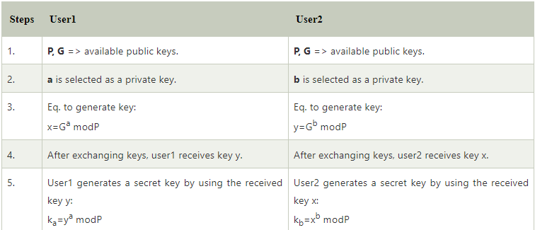

Slide 5
Aim:
To implement Diffie-Hellman key exchange algorithm using Java
Algorithm:
Enter the values for p and g
Enter the private key values of two users as a and b
Calculate
A = g^a mod p
B = g^b mod p
Calculate
Sa = B^a mod p
Sb = A^b mod p
Display the shared keys Sa and Sb

Slide 6
Program
import java.util.*;
class DiffieHellmanAlgorithmExample {
public static void main(String[] args)
{
long P, G, x, a, y, b, ka, kb;
Scanner sc = new Scanner(System.in);
System.out.println("Both the users should be agreed upon the public keys G and P");
System.out.println("Enter value for public key G:");
G = sc.nextLong();
System.out.println("Enter value for public key P:");
P = sc.nextLong();
System.out.println("Enter value for private key a selected by user1:");
a = sc.nextLong();
System.out.println("Enter value for private key b selected by user2:");
b = sc.nextLong();
x = calculatePower(G, a, P);
y = calculatePower(G, b, P);
ka = calculatePower(y, a, P);
kb = calculatePower(x, b, P);
System.out.println("Secret key for User1 is:" + ka);
System.out.println("Secret key for User2 is:" + kb);
}
// calculatePower() to find the value of x ^ y mod P
private static long calculatePower(long x, long y, long P)
{
long result = 0;
if (y == 1){
return x;
}
else{
result = ((long)Math.pow(x, y)) % P;
return result;
}
}
}

Slide 7
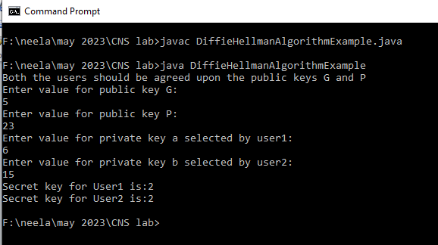
Output

